Slide 1


Slide 2

Daniel Anderson
Assistant Teaching Professor @ CMU
danielanderson.net

Slide 3
What we’ll learn today
How shared_ptr is implemented under the hood
Atomics and concurrency patterns
How existing atomic<shared_ptr> are implemented (the split reference count technique)
Deferred reclamation, i.e., garbage collection in C++
Some assumed knowledge
You’ve heard of lock-free programming and know what a compare_exchange is
You know roughly what atomic does and what it is used for
You’ve heard of shared_ptr
Things we won’t cover
Alias pointers, weak pointers

Slide 4
What we’ll learn today
How shared_ptr is implemented under the hood
Atomics and concurrency patterns
How existing atomic<shared_ptr> are implemented (the split reference count technique)
Deferred reclamation, i.e., garbage collection in C++
Some assumed knowledge
You’ve heard of lock-free programming and know what a compare_exchange is
You know roughly what atomic does and what it is used for
You’ve heard of shared_ptr
Things we won’t cover
Alias pointers, weak pointers

Slide 5

Why is this important?

Slide 6
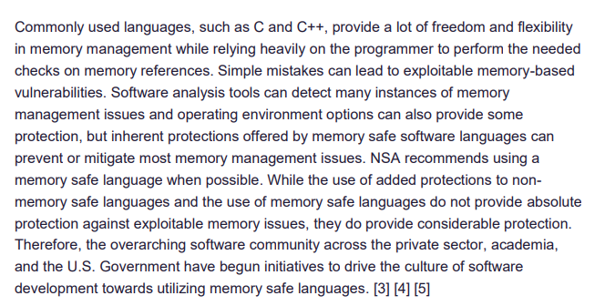
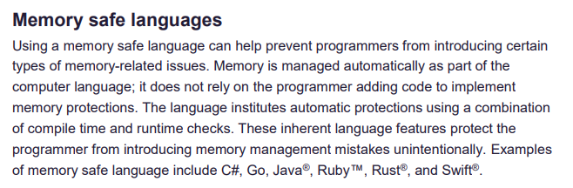
Why is this important?

Slide 7




Why is this important?

Slide 8



Why is this important?

Slide 9
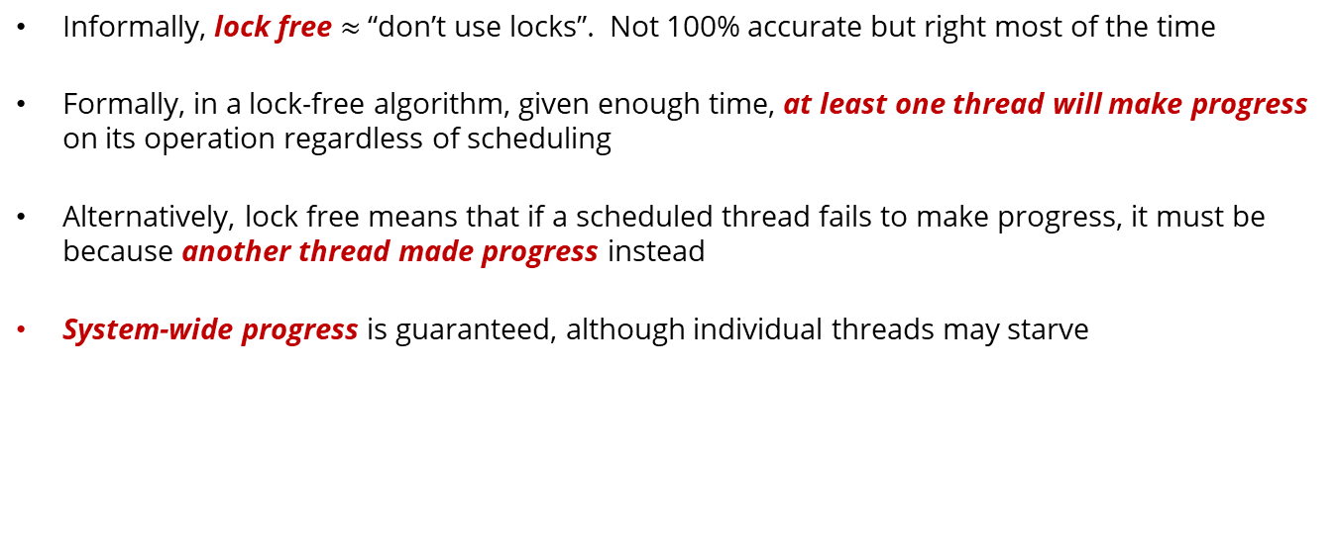
Lock-freedom
Informally, lock free $≈$ “don’t use locks”. Not 100% accurate but right most of the time
Formally, in a lock-free algorithm, given enough time, at least one thread will make progress on its operation regardless of scheduling
Alternatively, lock free means that if a scheduled thread fails to make progress, it must be because another thread made progress instead
System-wide progress is guaranteed, although individual threads may starve

Slide 10
std::shared_ptr

Slide 11
std::shared_ptr (the basics)
shared_ptr<T> s1:
T
T* ptr;
control_block* ctrl;
control_block:
atomic<long> ref_count = 1; …

Slide 12
std::shared_ptr (the basics)
shared_ptr<T> s1:
T
T* ptr;
control_block* ctrl;
control_block:
atomic<long> ref_count = 2; …
T* ptr;
control_block* ctrl;
shared_ptr<T> s2:

Slide 13
std::shared_ptr (the basics)
T
control_block:
atomic<long> ref_count = 1; …
T* ptr;
control_block* ctrl;
shared_ptr<T> s2:

Slide 14
std::shared_ptr (the basics)
T
control_block:
atomic<long> ref_count = 0; …

Slide 15
std::atomic<std::shared_ptr>

Slide 16

std::atomic<std::shared_ptr>
Atomic shared pointers were introduced to answer the age-old question…

Slide 17

std::atomic<std::shared_ptr>
Thread 1 std::shared_ptr<T> s1
T
Thread 2 std::shared_ptr<T> s2
3
2
0
1
2
ref_count = …
std::shared_ptr<T> s3 = s2;
s3 = other_thing;
Thread 3 std::shared_ptr<T> s4 = s3;

Slide 18
std::atomic<std::shared_ptr>
atomic<shared_ptr>: Holds a shared_ptr that can be manipulated atomically!
void store(shared_ptr<T> desired)
shared_ptr<T> load()
bool compare_exchange_weak(shared_ptr<T>& expected, shared_ptr<T> desired)
…
compare_exchange(expected, desired) {
if (current_value == expected) current_value = desired
else expected = current_value
}

Slide 19
std::atomic<std::shared_ptr>
How many lines does it take to implement a lock-free & memory-safe stack?
template<typename T>
struct Stack {
struct Node { T t; shared_ptr<Node> next; };
atomic<shared_ptr<Node>> head;
void push_front(T t) {
auto p = make_shared<Node>(std::move(t), head.load());
while (!head.compare_exchange_weak(p->next, p)) {}
}
optional<T> pop_front() {
auto p = head.load();
while (p != nullptr && !head.compare_exchange_weak(p, p->next)) { }
if (p != nullptr) return {std::move(p->t)};
else return {};
}
};

Slide 20



std::atomic<std::shared_ptr>
How many lines does it take to implement a lock-free & memory-safe stack?
atomic<shared_ptr>
Since GCC-12
Since MSVC v19.30
Lock free?
Not lock free
Not lock free

Slide 21
But, why?

Slide 22
The problem
atomic<shared_ptr<T>> a
atomic<long> ref_count = 1; …
T
++
--
If this happens first…
Thread 1 auto s = a.load();
Thread 2 a.store(make_shared<T>(…));

Slide 23
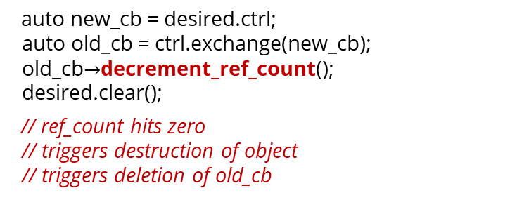
The fundamental problem: The race to zero
Thread 1
load():
Thread 2
store(shared_ptr desired):
auto cb = ctrl.load();
auto new_cb = desired.ctrl; auto old_cb = ctrl.exchange(new_cb); old_cb$→$decrement_ref_count(); desired.clear();
// ref_count hits zero // triggers destruction of object // triggers deletion of old_cb
Need a way to ensure that cb is not deleted before we increment the ref count
cb$→$increment_ref_count(); // use-after-free

Slide 24
Solutions

Slide 25
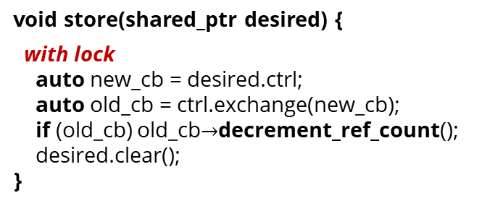
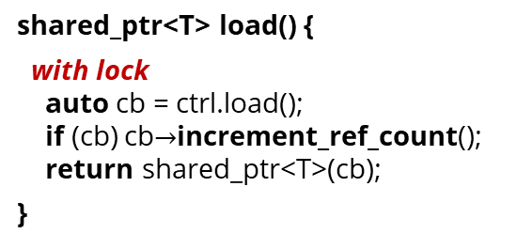
Solution #1: Locking!
Used by both libstdc++ (GCC) and Microsoft STL (MSVC)
Explicit mutex is (thankfully) not used by either implementation
Both use the lowest-order bits on the control_block pointer as a lock
shared_ptr<T> load() {
with lock auto cb = ctrl.load(); if (cb) cb$→$increment_ref_count(); return shared_ptr<T>(cb);
}
void store(shared_ptr desired) {
with lock auto new_cb = desired.ctrl; auto old_cb = ctrl.exchange(new_cb); if (old_cb) old_cb$→$decrement_ref_count(); desired.clear(); }

Slide 26
Solution #2: The split reference count
Used by Folly (Facebook open-source library, used in production),
Used by JustThreads (Anthony Williams’ commercial concurrency library),
Anthony Williams also has a free, simplified version on GitHub
Other implementations exist, e.g., a hobby project on GitHub by Vladislav Tyulbashev
Key idea: If we could atomically load the control_block pointer and increment the reference count at the same time, we would avoid the race to zero

Slide 27
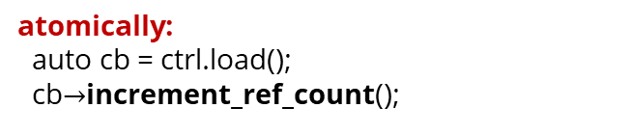
Solution #2: The split reference count
atomic<shared_ptr<T>>
std::atomic<control_block*> ctrl
atomically: auto cb = ctrl.load(); cb$→$increment_ref_count();
control_block
atomic<long> ref_count …
Introduce a second layer of reference counting on the atomic<shared_ptr> instance itself!
atomic<shared_ptr<T>>
Big idea: local_ref_count counts the number of in-flight atomic loads on the currently stored pointer
struct counted_cb { control_block* ctrl; long local_ref_count;
}; std::atomic<counted_cb> cctrl;

Slide 28
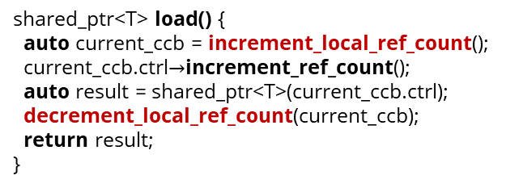
Solution #2: The split reference count
atomic<shared_ptr<T>>
counted_cb increment_local_ref_count() { counted_cb old_ccb = cctrl.load(), new_ccb; do { new_ccb = old_ccb; new_ccb.local_ref_count++; } while (!cctrl.compare_exchange(old_ccb , new_ccb)) return new_ccb; }
struct counted_cb { control_block* ctrl; long local_ref_count;
}; std::atomic<counted_cb> cctrl;
shared_ptr<T> load() { auto current_ccb = increment_local_ref_count(); current_ccb.ctrl$→$increment_ref_count(); auto result = shared_ptr<T>(current_ccb.ctrl); decrement_local_ref_count(current_ccb); return result; }
void decrement_local_ref_count(counted_cb prev_ccb) { counted_cb old_ccb = prev_ccb, new_ccb; do { new_ccb = old_ccb; new_ccb.local_ref_count--; } while (old_ccb.ctrl == prev_ccb.ctrl && !cctrl.compare_exchange(old_ccb , new_ccb)) if (old_ccb.ctrl != prev_ccb.ctrl) { ??? } }
What happens when a concurrent operation changes the pointer to a different shared_ptr?
Disclaimer: Slide code omits some nullptr checks to save space.

Slide 29
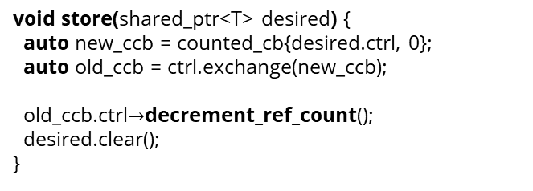
Solution #2: The split reference count
atomic<shared_ptr<T>>
void store(shared_ptr<T> desired) { auto new_ccb = counted_cb{desired.ctrl, 0}; auto old_ccb = ctrl.exchange(new_ccb); old_ccb.ctrl$→$decrement_ref_count(); desired.clear(); }
struct counted_cb { control_block* ctrl; long local_ref_count;
}; std::atomic<counted_cb> cctrl;
old_ccb$.$ctrl$→$add_ref_count(old_ccb.local_ref_count);
void decrement_local_ref_count(counted_cb prev_ccb) { counted_cb old_ccb = prev_ccb, new_ccb; do { new_ccb = old_ccb; new_ccb.local_ref_count--; } while (old_ccb.ctrl == prev_ccb.ctrl && !cctrl.compare_exchange(old_ccb , new_ccb)) if (old_ccb.ctrl != prev_ccb.ctrl) { // A store must have moved my local count to the global count
} }
The store operation helps an in-flight load by moving its local_ref_count onto the global ref_count
prev_ccb.ctrl$→$decrement_ref_count();

Slide 30
Solution #2: The split reference count
atomic<shared_ptr<T>>
Implementation options
struct counted_cb { control_block* ctrl; long local_ref_count;
}; std::atomic<counted_cb> cctrl;
Rely on hardware support for 16-byte atomics.
Generally ubiquitous and widely available.
std::atomic might not work…
Can use boost::atomic instead! ☺
Used by Anthony Williams’ implementation
Hang on… that’s 16 bytes
Pack the pointer and local_ref_count together into 8 bytes. This gives 16 bits of counter.
Valid on x86-64 at least
Used by Folly’s implementation
struct PackedPtr {
signed long long ptr : 48;
unsigned long long local_ref_cnt : 16;
};

Slide 31
Something new
Notes:
30-minute mark

Slide 32
Solution #3
Recall the fundamental problem:
load():
The race to zero
store(shared_ptr desired):
auto cb = ctrl.load();
auto new_cb = desired.ctrl; auto old_cb = ctrl.exchange(new_cb); old_cb$→$decrement_ref_count(); desired.clear();
// ref_count hits zero // triggers destruction of object // triggers deletion of old_cb
We need to guarantee that cb is not deleted until after we are finished reading it
cb$→$increment_ref_count(); // use-after-free
Sounds like a textbook use case of deferred reclamation

Slide 33
Deferred reclamation: A quick primer
atomic<T*> src
T* protect(const std::atomic<T*>& src)
Atomically read the value of src with the guarantee that no other thread will delete this value until after it is released.
void retire(T* p)
Indicate that an object has been removed from the source and should be deleted.
Deletion is delayed if that value has been protected since before it was removed.
Occasionally (e.g., once per 1000 retires), clean up unprotected garbage that has accumulated
void release()
Release the protection on the protected value
Often done automatically through RAII types
Common implementations:
Hazard pointers (Concurrency TS2)
RCU (Concurrency TS2)
Notes:
40-minute mark

Slide 34
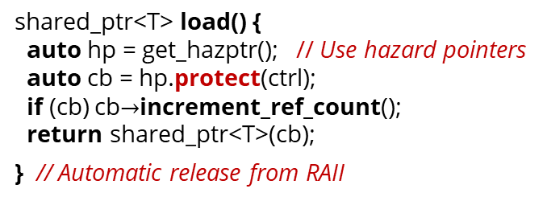
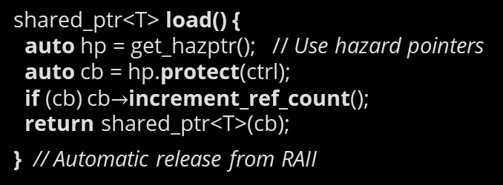
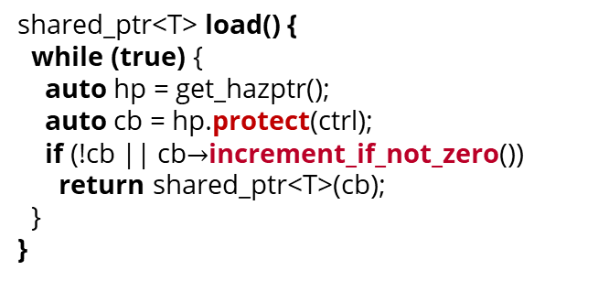
Solution #3: Deferred reclamation
First attempt: Protect then increment
Correct: Protect then increment if not zero
shared_ptr<T> load() { auto hp = get_hazptr(); // Use hazard pointers auto cb = hp.protect(ctrl); if (cb) cb$→$increment_ref_count(); return shared_ptr<T>(cb);
} // Automatic release from RAII
shared_ptr<T> load() { auto hp = get_hazptr(); // Use hazard pointers auto cb = hp.protect(ctrl); if (cb) cb$→$increment_ref_count(); return shared_ptr<T>(cb);
} // Automatic release from RAII
shared_ptr<T> load() { while (true) { auto hp = get_hazptr(); auto cb = hp.protect(ctrl); if (!cb || cb$→$increment_if_not_zero()) return shared_ptr<T>(cb); } }
Q1: Does this prevent the use-after-free on the control block?
Atomically increment the ref count if its not zero, otherwise return false. Required by std::weak_ptr::lock()
This might increment the reference count from zero!!!
Q2: Is this code correct?

Slide 35
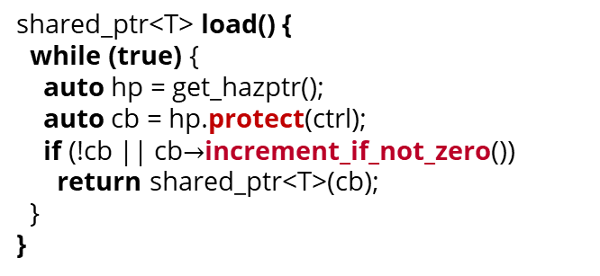
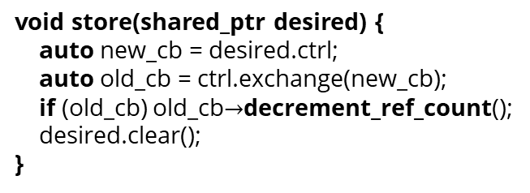
Solution #3: Deferred reclamation
void store(shared_ptr desired) { auto new_cb = desired.ctrl; auto old_cb = ctrl.exchange(new_cb); if (old_cb) old_cb$→$decrement_ref_count(); desired.clear(); }
void control_block::decrement_ref_count() { if (ref_count.fetch_sub(1) == 1) { dispose(); // Delete the managed object delete this; // Delete the control block } }
retire(this); // Retire the control block
Intentionally ignoring the weak reference count and the possibility of custom allocators for simplicity…
shared_ptr<T> load() { while (true) { auto hp = get_hazptr(); auto cb = hp.protect(ctrl); if (!cb || cb$→$increment_if_not_zero()) return shared_ptr<T>(cb); } }

Slide 36
Performance

Slide 37
Benchmarking atomic<shared_ptr>
Benchmarking multithreaded/lock-free code is hard…
There are many factors to consider:
Measurement: Throughput vs latency?
Workload: Proportion of reads vs writes
Hotness: Does the data fit in cache?
Contention: How many threads operation on the same location?
We will benchmark the lock-free stack implementation, using different atomic<shared_ptrs>!
struct Node { T t; shared_ptr<Node> next; };
atomic<shared_ptr<Node>> head;
void push_front(T t) {
auto p = make_shared<Node>(std::move(t), head.load());
while (!head.compare_exchange_weak(p->next, p)) {}
}
optional<T> pop_front() {
auto p = head.load();
while (p && !head.compare_exchange_weak(p, p->next)) { }
if (p) return {std::move(p->t)};
else return {};
}

Slide 38
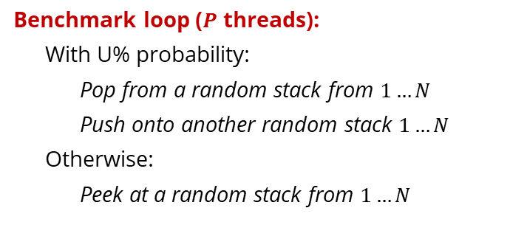

Benchmark setup (throughput)
We have $P$ threads: vary $P$ to control contention and throughput
We have $N$ atomic_stacks: vary $N$ to control contention and hotness
Perform $U\%$ push/pops, rest are peeks: vary $U$ to control read/write workload
Benchmark loop ($P$ threads):
With U% probability:
Pop from a random stack from $1…N$
Push onto another random stack $1…N$
Otherwise:
Peek at a random stack from $1…N$
Machine setup:
4x Xeon E7-8867 (72 cores, 144 hyperthreads)
1TB DDR4 main memory
Running Ubuntu 20.04
Compiling with GCC 13

Slide 39
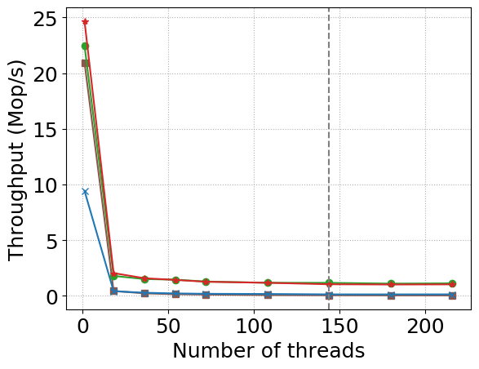
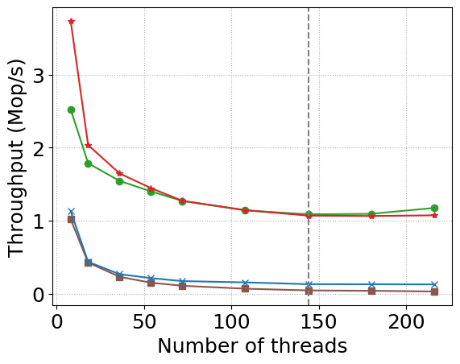
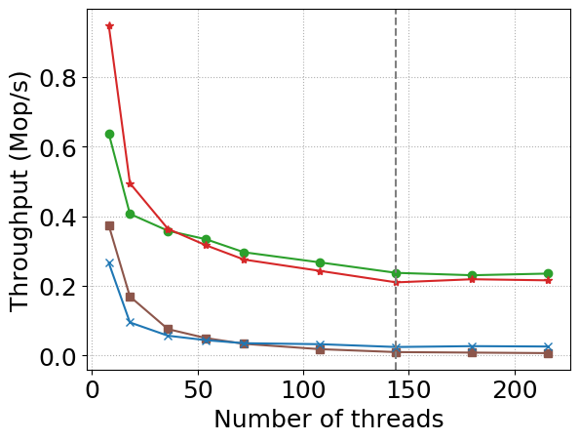
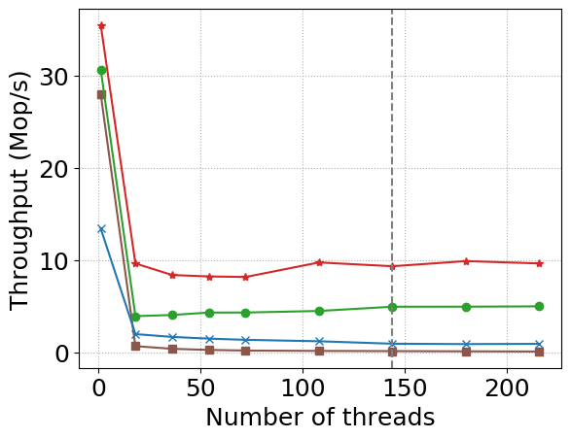
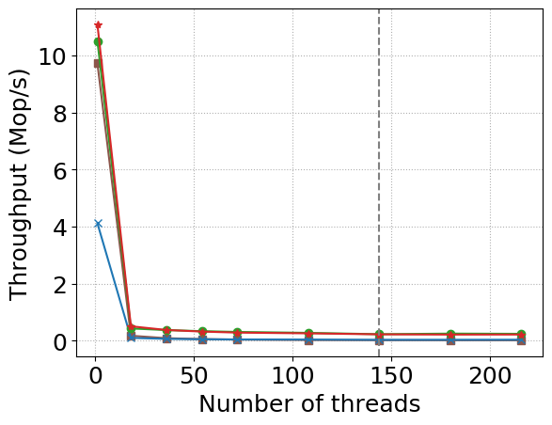
Benchmarks: $N=1$ (high contention, hot in cache)
U=1%
U=10%
U=50%
Libstdc++
Williams
Folly
Mine

Slide 40
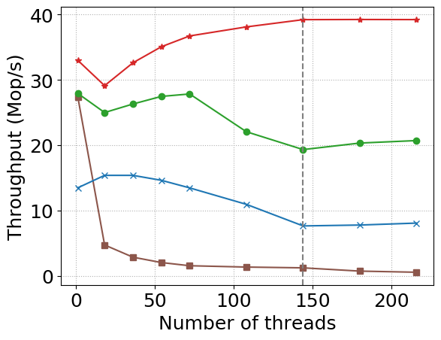
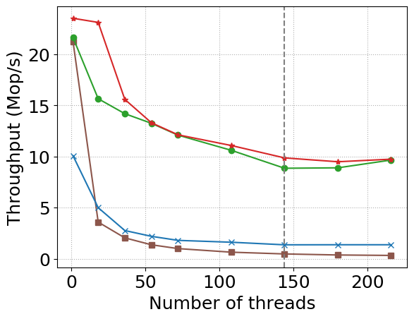
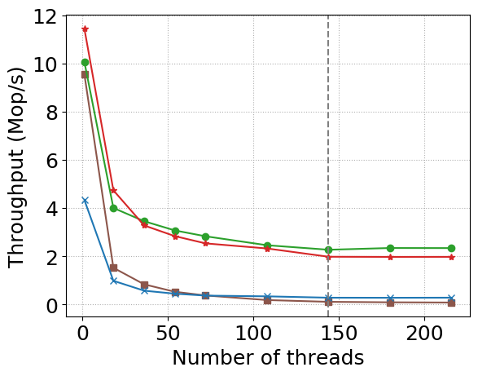
Benchmarks: $N=10$ (moderate contention, hot in cache)
U=1%
U=10%
U=50%
Libstdc++
Williams
Folly
Mine

Slide 41
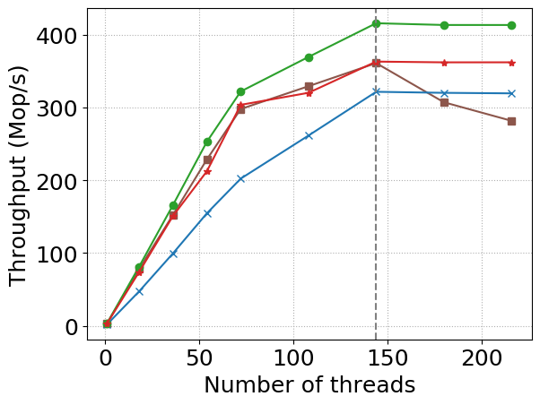
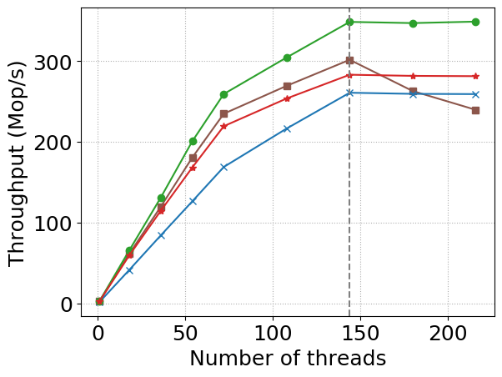
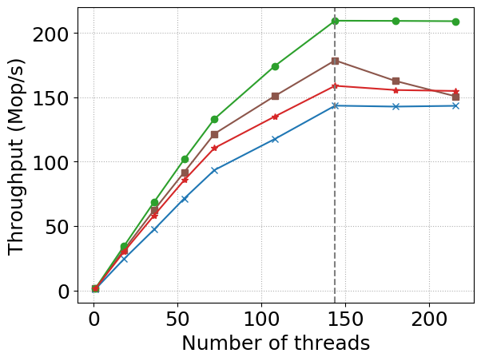
Benchmarks: $N=10^{6}$ (low contention, cold cache)
U=1%
U=10%
U=50%
Libstdc++
Williams
Folly
Mine

Slide 42
Conclusion & Future work
My implementation is here: https://github.com/DanielLiamAnderson/atomic_shared_ptr
Still a proof-of-concept / prototype state
Need to implement atomic<weak_ptr>
Need to implement alias pointers
Possible avenues for further work
Hybrid algorithm? Can we do a mixture of split reference count and deferred reclamation to get performance that is always competitive with both?
More work on optimizing for low latency (see the GitHub, there is some preliminary work!)
Thanks to Guy Blelloch and Hao Wei for their collaboration on some of this work

Slide 43
Bonus Content: Latency

Slide 44
Optimizing latency (work in progress)
Throughput experiments show that the average latency is quite low.
What about the tail latency? Is there anything to be suspicious of?
Deamortization
Instead of: Once per 1000 retires, clean up unprotected garbage that has accumulated
We do: Each retire, clean up one or two pieces of unprotected garbage, and scan one thread’s protected pointer.
Requires pipelining the garbage sets and the protected pointer sets so that we only reclaim garbage from before the protected pointers were announced
void retire(T* p)
Indicate that an object has been removed from the source and should be deleted.
Deletion is delayed if that value has been protected since before it was removed.
Occasionally (e.g., once per 1000 retires), clean up unprotected garbage that has accumulated

Slide 45
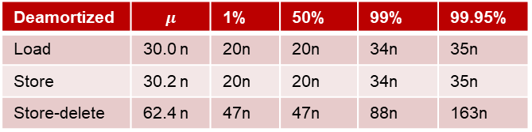
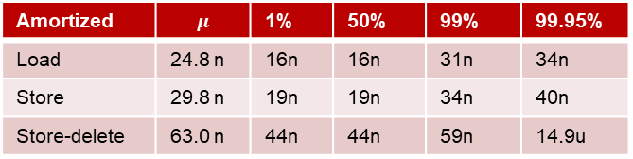
Amortized vs deamortized latency
Amortized | $$μ$$ | 1% | 50% | 99% | 99.95%
Load | 24.8 n | 16n | 16n | 31n | 34n
Store | 29.8 n | 19n | 19n | 34n | 40n
Store-delete | 63.0 n | 44n | 44n | 59n | 14.9u
Deamortized | $$μ$$ | 1% | 50% | 99% | 99.95%
Load | 30.0 n | 20n | 20n | 34n | 35n
Store | 30.2 n | 20n | 20n | 34n | 35n
Store-delete | 62.4 n | 47n | 47n | 88n | 163n

